Slide 1

Unveiling Windows Hello: Exploring Passwordless Authentication

Slide 2


WHOAMI
Nikhil Singh
B. Tech (CSE) – 4th year
Code Jam R3 Qualifier
A FIFA, EA Sports FC fan
Ex – Intern, IBM Research India

Slide 3




AGENDA
1st
2nd
3rd
4th
Passwordless
Windows Hello
Exploiting
What’s Next?

Slide 4
BY THE END OF THIS TALK
WINDOWS HELLO AND ITS FEATURS
85%
USB & UVC
50%
CONFUSION
10%
FUN
MAX_ INT%

Slide 5
Part 1: Passwordless

Slide 6






WHY PASSWORDLESS?
WEAK
PASSWORDS
DATA BREACHES
PHISHING ATTACKS
REUSE

Slide 7














HOW PASSWORDLESS?
FINGERP RINT
FACE RECOGNITION
SECURITY
KEY
OTP

Slide 8



Part 2: Windows Hello

Slide 9




SAY____ _ TO WINDOWS_____!!
Passwordless
Windows Hello

Slide 10





EVERYONE CAN USE IT?
Domain & Azure
Authentication
Enterp ris e
Windows
Hello
Home
Replaces your local password

Slide 11







FEATURES
FACE RECOGNITION
IR sensor and advanced image analysis
PIN CODE
And it is not the same as password
FINGERPRINT
Same good old fingerprint login

Slide 12



FINGERPRINT
DATA
Challenging to capture and modify
PREVIOUS ART
Many public researches
PROTOCOL
Complicated protocol and lack of public implementation

Slide 13




PIN CODE
ANTI-BRUTEFORCE
Anti-bruteforce mechanism
SAME CHALLANGE
Same challenge as cracking a password

Slide 14


FACE RECOGNITION
ANTI-BRUTEFORCE
Anti-bruteforce mechanism
EASY START
NXP implemented a basic USB video camera
PUBLIC DATA
Face images can be captured easily

Slide 15



FACE RECOGNITION

Slide 16

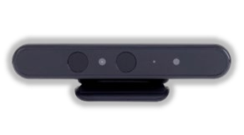
BIOMETRIC AUTH & WINDOWS HELLO
WBIOSRVC
Winbio.dll
Storage
Engine
Sensor
WinBioDatabase
App
Face Cred
Provider

Slide 17

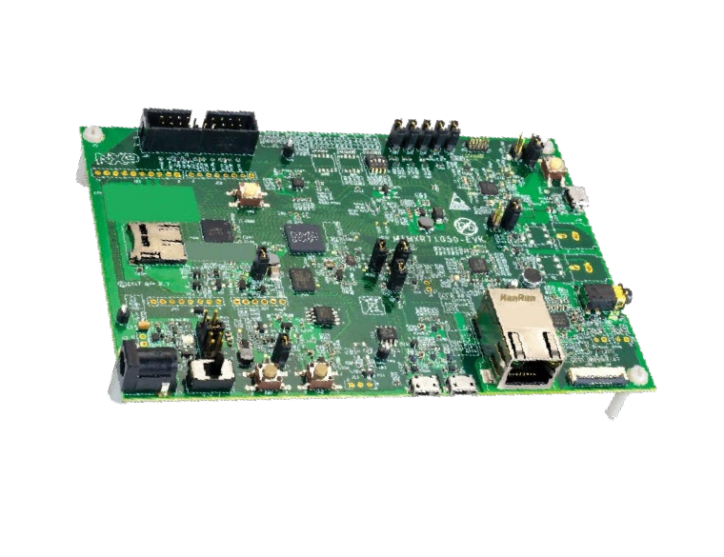
BIOMETRIC AUTH & WINDOWS HELLO
WBIOSRVC
Winbio .d ll
Storage
Engine
Sensor
WinBioDatabase
App
Face Cred Provider

Slide 18


NXP – EVALUATIO N BOARD

Slide 19







z
Part 3: Exploiting

Slide 20









RESEARCH VECTOR
ANALYZE
USB & UVC
MIMIC
Mimics `hello` camera
CAP TURE
Capture the target person
EXP LOIT
Bypass Windows Hello

Slide 21







ANALYZE
ANALYZE
USB Sp ecs
Cap ture Traffic

Slide 22
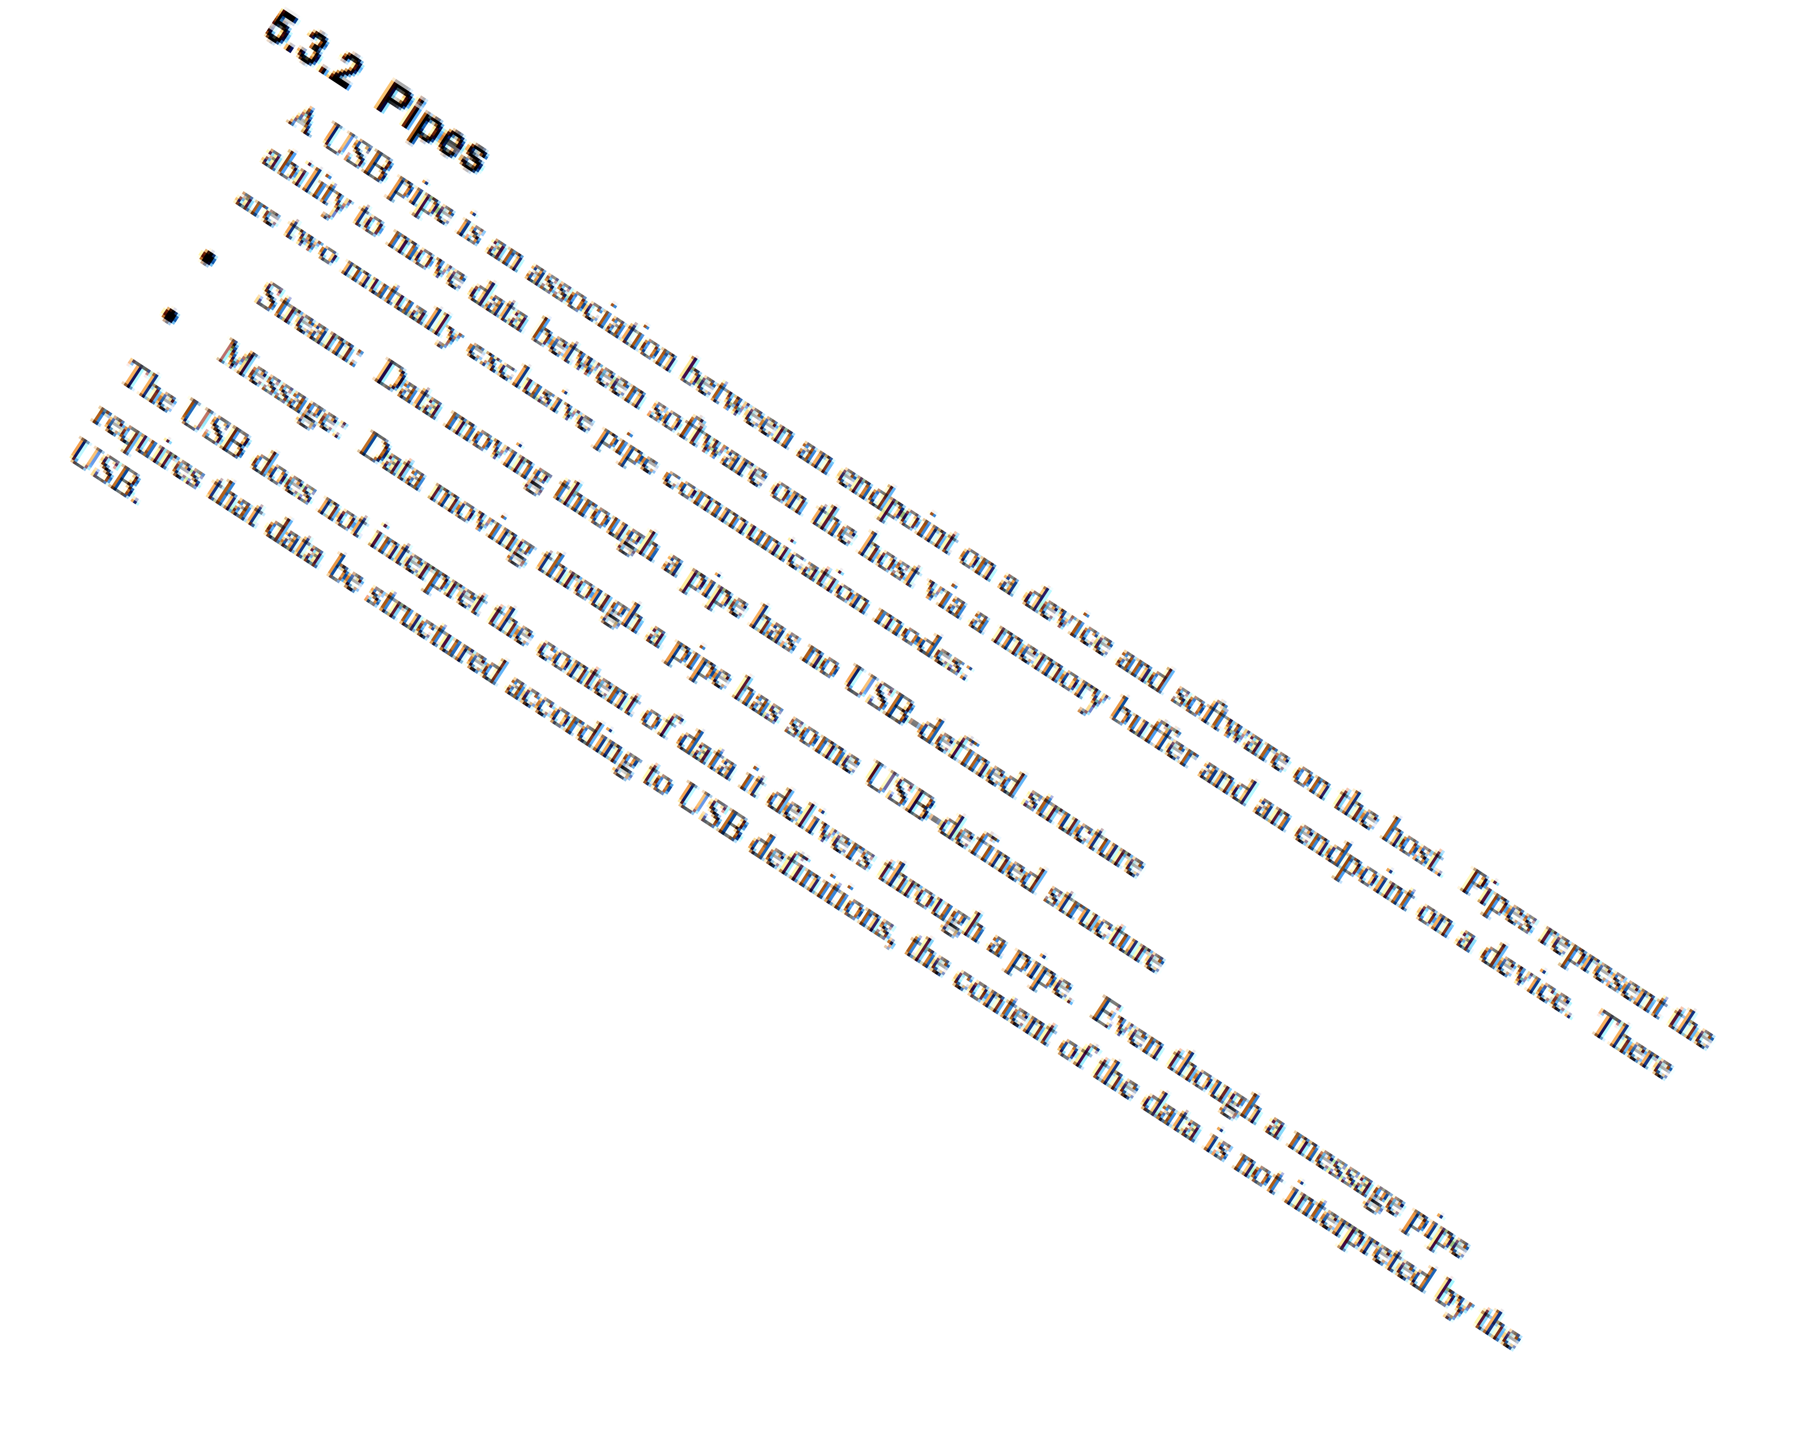
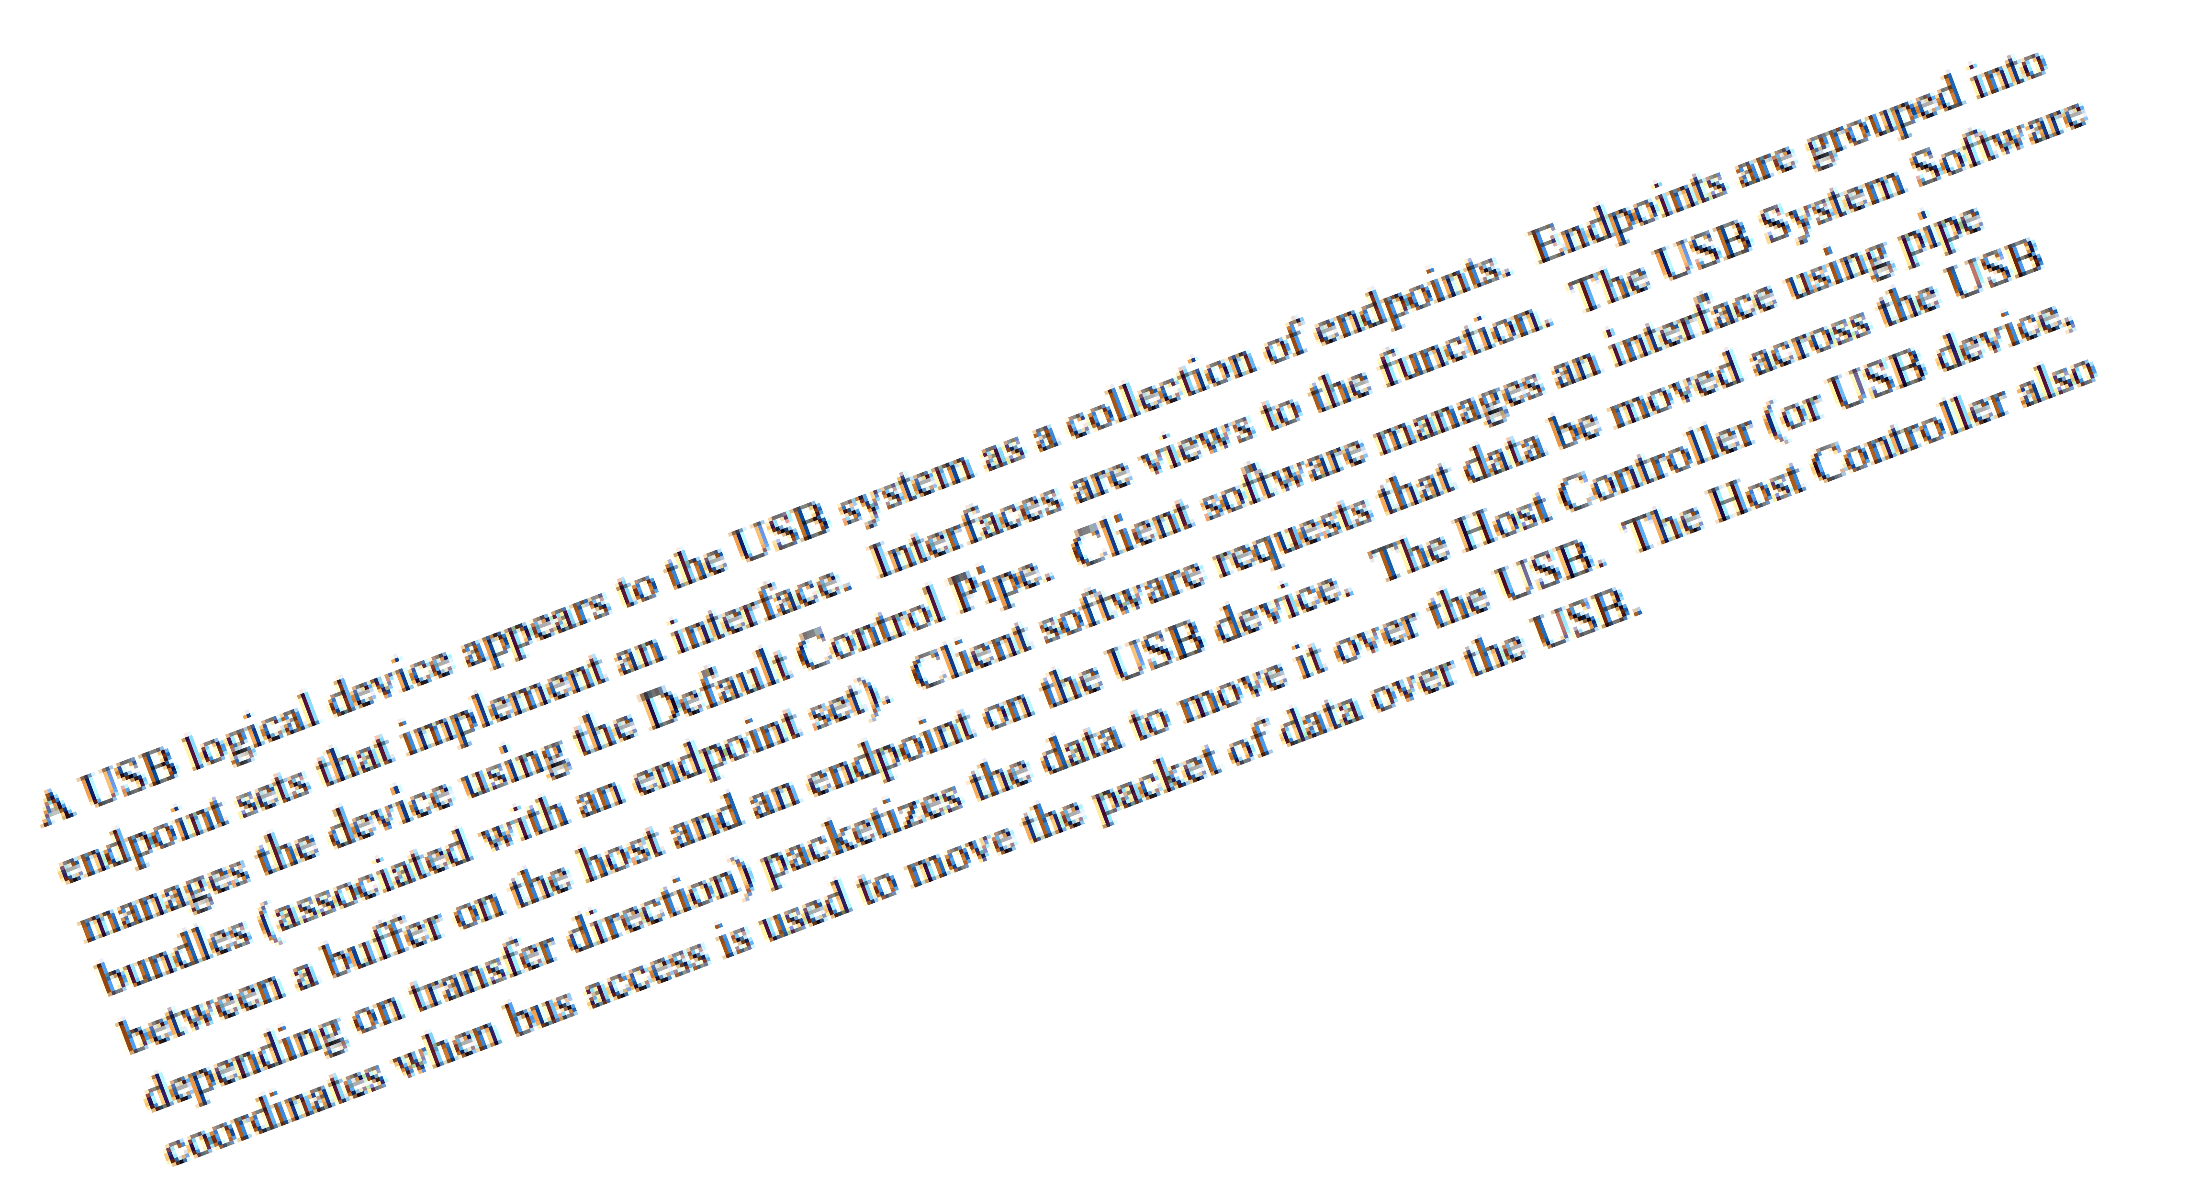
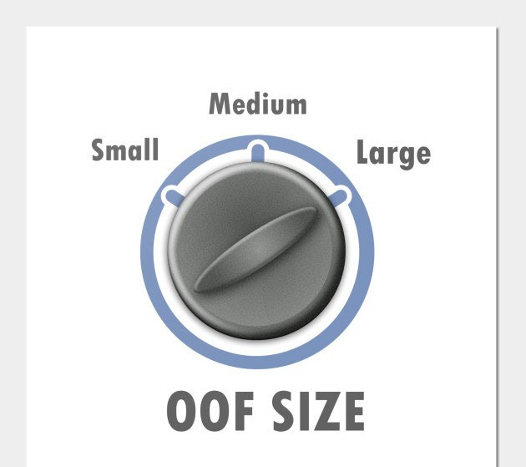
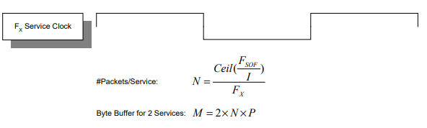
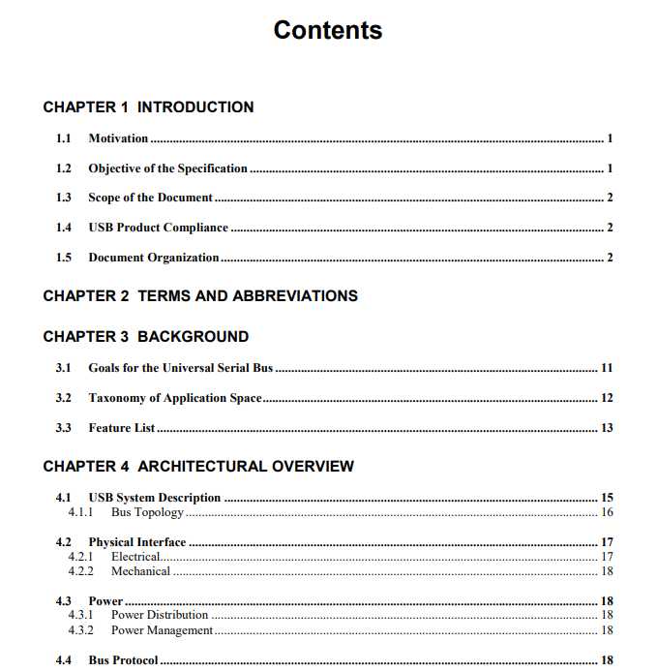
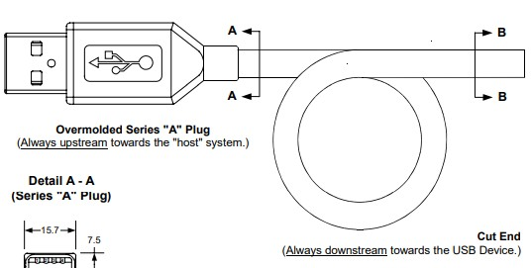
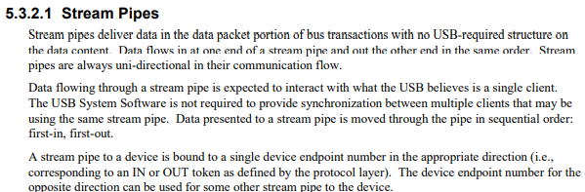
ANALYZE - USB SPECS

Slide 23

ANALYZE - USB STRUCTURE
NICE GUY

Slide 24


ANALYZE - USB STRUCTURE
HOSTin
NICE GUY
Bully

Slide 25
ANALYZE - USB STRUCTURE
Device Descrip tor
Config uration Descrip tor
Interface Descrip tor
End p o int Descrip tor
End p o int Descrip tor

Slide 26
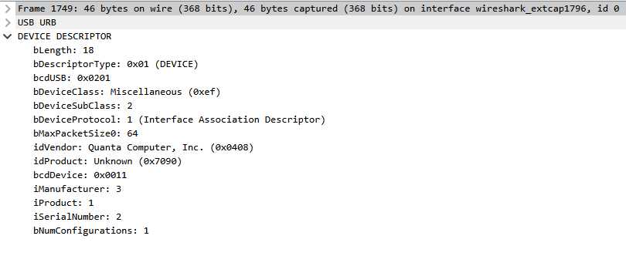
ANALYZE – USB STRUCTURE
Device
Descrip tor

Slide 27
ANALYZE – USB STRUCTURE
Device
Descrip tor

Slide 28
ANALYZE - USB STRUCTURE
Device
Descrip tor

Slide 29
ANALYZE - USB STRUCTURE
Device Descrip tor
Config uration Descrip tor
Interface Descrip tor
Endpoint
Descriptor
Endpoint
Descriptor

Slide 30
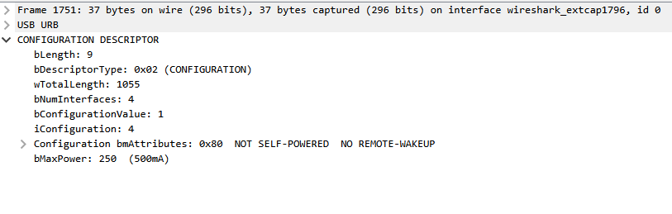
ANALYZE - USB STRUCTURE
Configuration
Descriptor

Slide 31
ANALYZE - USB STRUCTURE
Device Descrip tor
Config uration Descrip tor
Interface Descrip tor
Endpoint
Descrip tor
Endpoint
Descrip tor

Slide 32
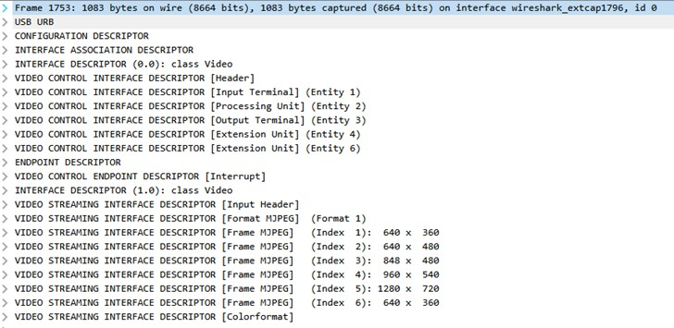
ANALYZE - USB STRUCTURE
Configuration
Descriptor

Slide 33
ANALYZE - USB STRUCTURE
NICE GUY

Slide 34

Wireshark to the rescue!

Slide 35
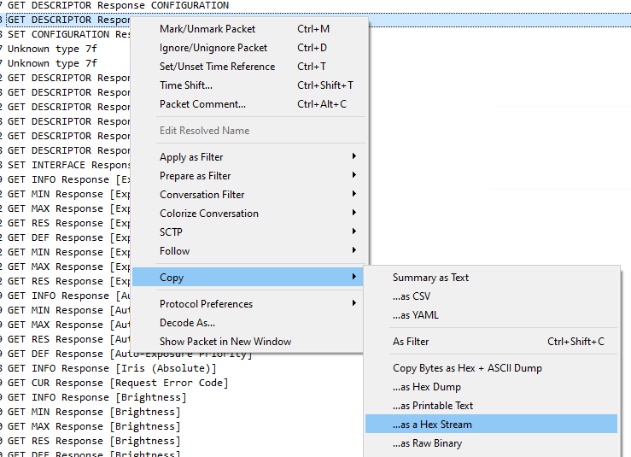
Wireshark to the rescue!

Slide 36






MIMIC
MIMIC
Implementation
Compatible w/ Win Hello

Slide 37
MIMIC
Configure the example project with the extracted descriptors
Added support for two cameras
We connected the USB device to the computer AND….

Slide 38
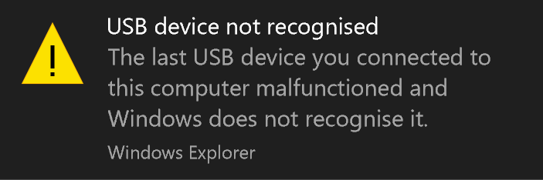
MIMIC

Slide 39
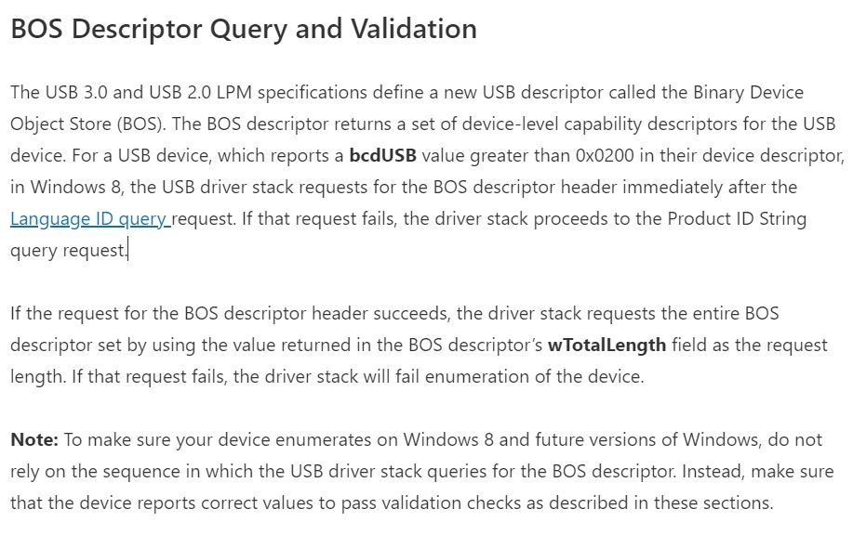
MIMIC

Slide 40
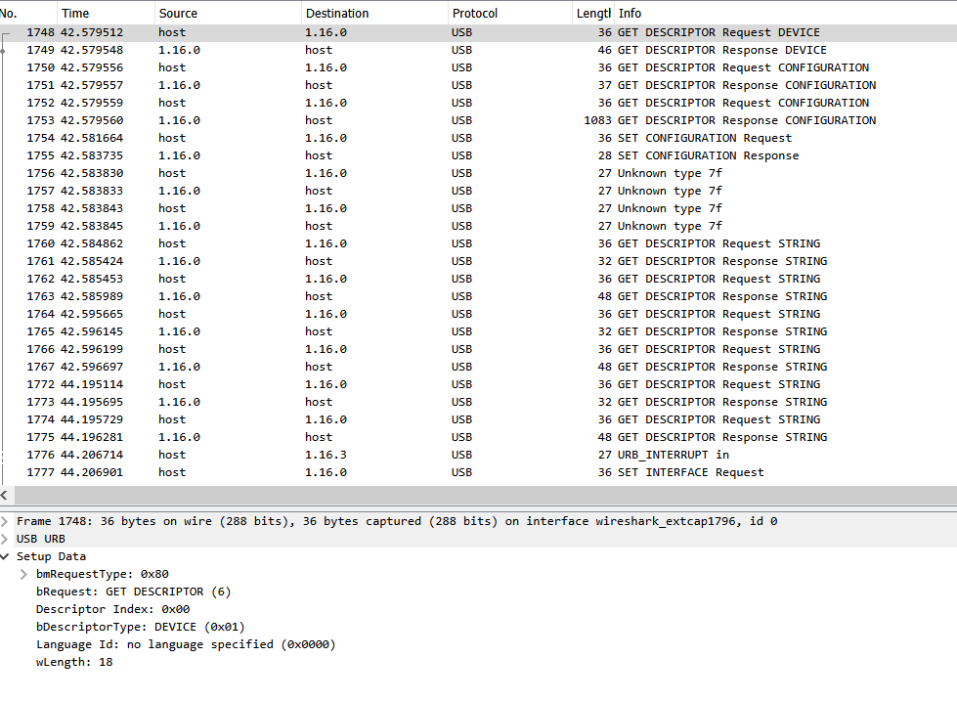

MIMIC
?

Slide 41
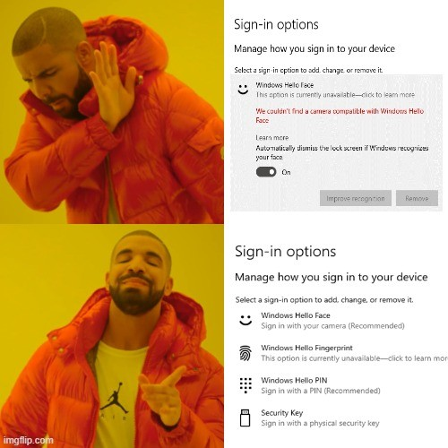
MIMIC

Slide 42





CAPTURE
CAPTURE
Capture color frames
Capture IR frames

Slide 43
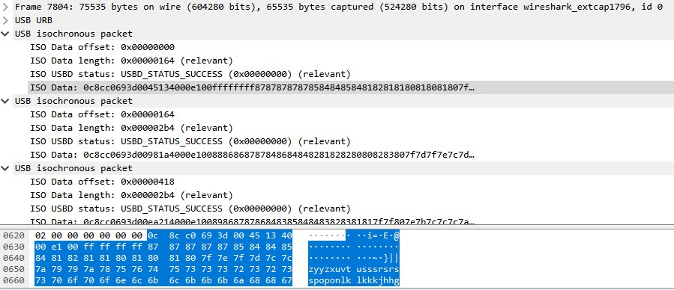
CAPTURE
Data Transfer

Slide 44
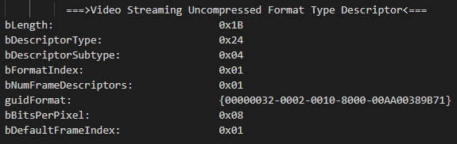
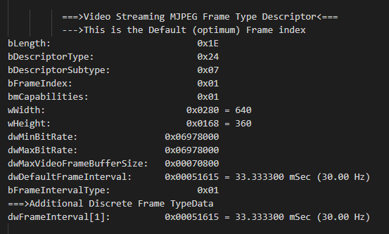
CAP TURE
Data Transfer

Slide 45
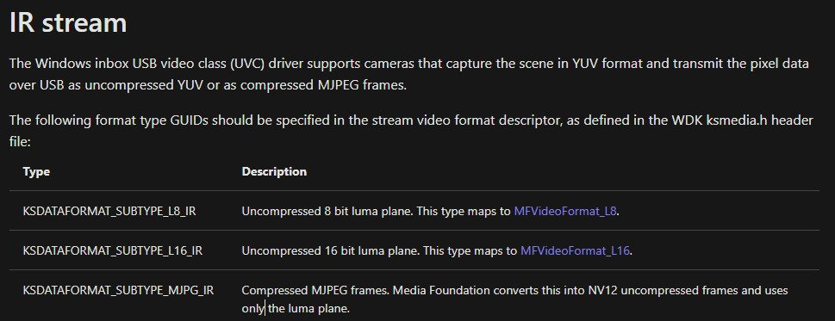
CAP TURE
Data Transfer

Slide 46
EXPLOIT
EXP LOIT
BYP ASS

Slide 47







EXPLOIT
PyShark
Save
Profit

Slide 48
EXPLOIT
PyShark
Save
Profit

Slide 49

EXPLOIT
MS Media
Framework
Save
Profit

Slide 50










EXPLOIT
1. The attacker captures or creates IR image of the victim.
Attacker
Nikhil
2. The attacker creates a custom USB device that impersonates a USB camera device.
6. The attacker gets access to sensitive information and files of the victim
3. The attacker saves the captured data on a custom USB device.
5. The biometrical system accepts the biometrical credentials and logs the user in.
4. The Attacker connects the custom USB device to Nikhil’s computer. The USB device transmits the captured IR image.
Nikhil’s Laptop

Slide 51
Part 4: What’s Next?
You say goodbye and I say…

Slide 52






What’s Next?
Converting coloured images to IR
Manipulating bio-database
Fuzzing

Slide 53








Closing Remarks!
2nd
4th
Windows Hello
USB
Password less
Fun
1st
3rd

Slide 54
Closing Remarks!
Don’t base your authentication on public factors.

Slide 55

Thank You! https://singhnikhil.netlify.app/

Slide 56


